Slide 1
Developing Web Parts
Creating customizable UI components
Notes:
In this module you will learn how to create custom Web Parts as well as address the complex scenarios such as creating custom verbs menus, custom editor parts, connecting two or more Web Parts together and leveraging asynchronous programming techniques.

Slide 2
Agenda
Overview of Web Parts
Creating Custom Web Parts
Persistent Properties
Custom Editor Parts
Advanced Web Part Development
Connectable Web Parts
Web Parts Verbs
Asynchronous Processing

Slide 3
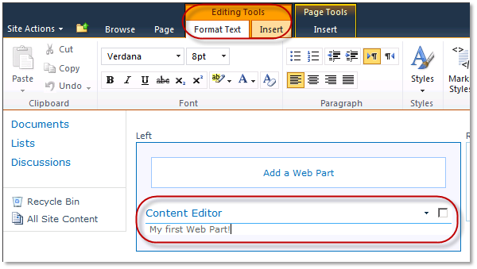
Web Parts
Web Parts are used to build portal-style applications
Content is modular, consistent and easy to navigate
Configurable chrome: border and title bar
Web Parts support for customization & personalization
Notes:
Web Parts are fundamental building blocks for the SharePoint user interface. A Web Part encapsulate a well defined functionality and can be placed on several pages within the SharePoint sites to which they are deployed.
Users can easily customize the border and title, and they can hide the Web Part on the page.

Slide 4
SharePoint Foundation Web Part Page Structure
Web Part Pages in SharePoint Foundation
Inherits from the SPF WebPartPage base class
Contains one SPWebPartManager control
Contains one or more SPF WebPartZone controls
SPWebPartManager
WebPartZone (Left)
WebPartZone (Right)
Editor Zone
Web Part 1
Web Part 3
Editor Part 1
Web Part 2
Web Part 4
Editor Part 2
Web Part 5
Catalog Zone
Catalog Part 1
Catalog Part 2
Notes:
A Web Part Page inherits from WebPartPage class residing in the Microsoft.SharePoint.WebPartPages namespace of the Microsoft.SharePoint.dll.
A SPWebPartManager control is responsible for managing the lifetime of Web Part instances as well as serializing Web Part related data that they can be stored and retrieved from the content database. A Web Part page can contain only one SPWebPartManager. The SPWebPartManagercontrol is already defined on the master page.
A Web Part page can contain one or more WebPartZone controls.

Slide 5
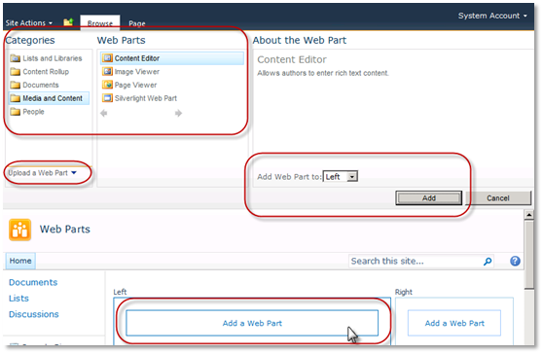
Adding Web Parts to a Page
Web Parts can be added to Web Part Zones or Rich Content areas (like on a wiki page)
Methods of adding Web Parts to pages:
From Web Part Gallery
Via importing Web Part Definition file
Most Web Part interaction via server Ribbon
Web Part Task Pane still exists
Notes:
Web parts can only be added to Web Part Zones or Rich Content areas, like on a wiki page.
There are a number of standard Web Parts that come with SharePoint 2010, but you can also develop your own Web Parts.
You can add Web Parts to a Web Part page or a wiki page from the Web Part Gallery.

Slide 6
DEMO
Inspecting the Web Part Gallery

Slide 7
Agenda
Overview of Web Parts
Creating Custom Web Parts
Persistent Properties
Custom Editor Parts
Advanced Web Part Development
Connectable Web Parts
Web Parts Verbs
Asynchronous Processing

Slide 8
Overview of Developing Web Parts
SharePoint Developer Tools supports two types
Web Part: an ASP.NET 2.0 server control style
Visual Web Part: an ASP.NET 2.0 user control style (*.ASCX)
Steps to creating a custom Web Part:
Create Web Part SPI & implement business logic
Package & deploy Web Part files
Feature used to push *.webpart file to Web Part Gallery
Notes:
In SharePoint 2007 you can develop custom Web Parts, but the user interface must be built up with server controls.
In SharePoint 2010 you have also Visual Web Parts where you can define the user interface in a *.ascx user control. The user control is loaded into the Web Part when the Web Part is loaded.
You can develop Web Parts using the Visual Studio 2010 Tools for SharePoint. You have 2 SPIs: one for a classic Web Part and one for a Visual Web Part.

Slide 9
Creating the Custom Web Part Object
Build a typical ASP.NET 2.0 server control:
Create a new class that inherits from: System.Web.UI.WebControls.WebParts.WebPart
Override CreateChildControls()
Used to add any child controls to the page such as buttons, textboxes, labels, etc.
Override RenderContents()
Renders the contents of the Web Part, inside the outer tags and Web Part chrome
Never override Render()!!!!
SharePoint overrides Render() to include the Web Part chrome and outer tags
Notes:
A Web Part inherits from the WebPart class residing in the System.Web.UI.WebControls.WebParts namespace of the System.Web.dll.
Instantiate the controls that make up the user interface in the CreateChildControls() method.

Slide 10
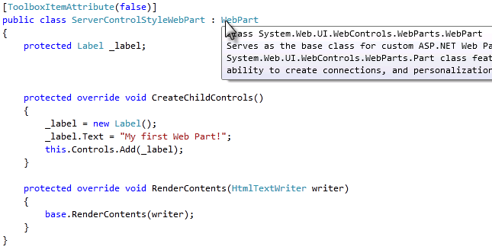
Creating Custom Web Parts
Web Parts derive from the WebPart base class
All Web Parts inherit common functionally
SPF has its own WebPart class that inherits from the ASP.NET 2.0 WebPart class
Recommended to use the ASP.NET 2.0 class
Notes:
When you create your own custom Web Parts you have to derive your Web Part from the WebPart class residing in the System.Web.UI.WebControls.WebParts namespace of the System.Web.dll.
SharePoint has its own WebPart class in the Microsoft.SharePoint.WebPartPages namespace but it is only there for backward compatibility with SharePoint 2003.

Slide 11
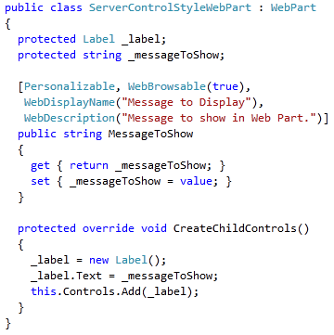
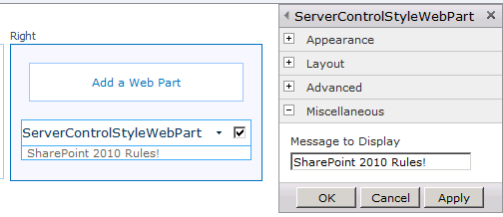
Persistent Web Part Properties
Web Parts support persistent properties:
Customization data is seen by all users
Personalization data is seen only by one user
Customized by code attributes on public property
Notes:
Web Parts can expose properties. When writing your properties you can apply a number of attributes:
WebBrowsable: the property can be set in the Web Part task pane.
Personalizable: users can personalize data. In that case it is seen only by one user.
WebDisplayName: sets the text of the label that is rendered just before the control.

Slide 12
DEMO
Creating Custom Web Parts

Slide 13
Agenda
Overview of Web Parts
Creating Custom Web Parts
Persistent Properties
Custom Editor Parts
Advanced Web Part Development
Connectable Web Parts
Web Parts Verbs
Asynchronous Processing

Slide 14
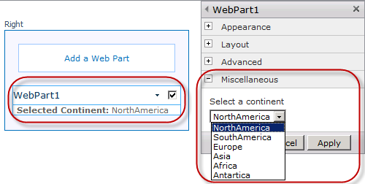
Standard Editor Parts
SharePoint Foundation provides standard Editor Parts
OOTB Editor Parts use TextBox & DropDownList controls for all persistent properties
DropDownList only used for boolean & enumeration types
Notes:
SharePoint provides standard Editor Parts. They use TextBox and DropDownList controls to represent the Web Part properties.

Slide 15
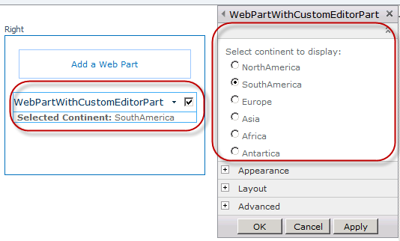
Custom Editor Parts
Custom Editor Parts provide more control than OOTB Editor Parts
Control over rendering
Control over validation
Not limited to just TextBox & DropDownList controls
Notes:
When the way Web Parts render your custom persistent properties is not good enough, you can develop your own custom editor parts. This gives you more control over the way the properties are rendered and validated.
You can use almost any control in the editor part.

Slide 16
Creating Custom Editor Parts
Creating custom editor part very similar to creating custom Web Parts
CreateChildControls() / RenderContents()
Steps to creating custom editor parts:
Inherit from EditorPart class
Implement two necessary methods in editor part
SyncChanges(): runs when editor part first shown
ApplyChanges(): runs when OK / Apply button clicked
Within the WebPart class, override CreateEditorParts()
Create and return a new collection of editor parts to Web Part Framework that includes custom editor part
Notes:
A custom Editor part inherits from the EditorPart class. Use the CreateChildControls() method to instantiate the controls that represent the user interface of the editor part, and the RenderContents to render the content of the Editor Part.
Implement the SynchChanges() method to render the property values that are already stored. When the Editor Part loads, it is the SynchChanges() method that applies the initial values to the Editor Part (and not the OnLoad or CreateChildControls method).
Implement the ApplyChanges() method to persist the settings in the editor part into the Web Part.
Override the CreateEditorParts() method to add your custom editor part to the collection of editor parts.

Slide 17
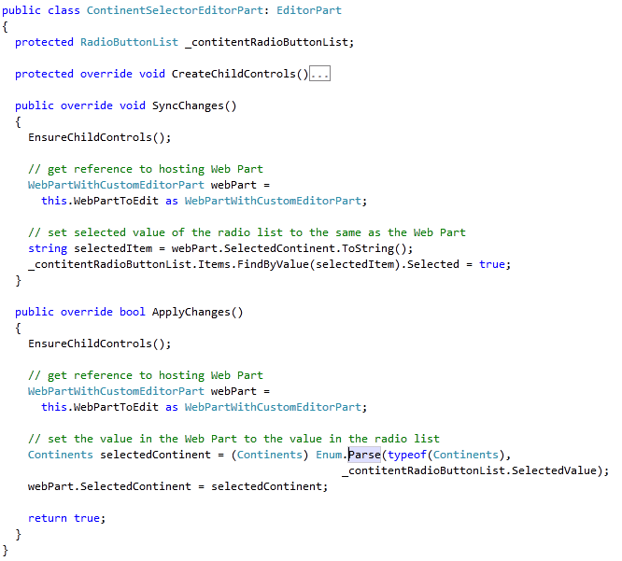
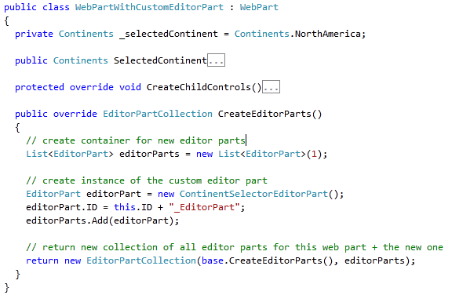
Creating Custom Editor Parts
Notes:
This sample code demonstrates how to add your custom Editor Part to the Web Part by overriding the CreateEditorParts() method.
The Editor Parts of a Web Part are collected into a collection of type EditorPartCollection. This collection is immutable, so you cannot add a custom Editor Part directly to it, but it has a constructor that takes an existing EditorPartCollection and a Icollection of (new) Editor Parts.

Slide 18
DEMO
Creating Custom Editor Parts

Slide 19
Agenda
Overview of Web Parts
Creating Custom Web Parts
Persistent Properties
Custom Editor Parts
Advanced Web Part Development
Connectable Web Parts
Web Parts Verbs
Asynchronous Processing

Slide 20
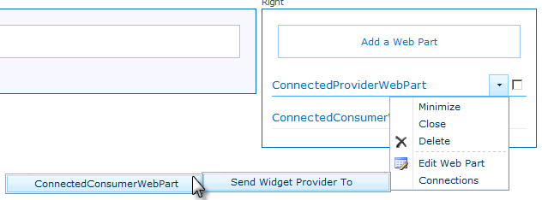
Web Part Connections
ASP.NET provides Web Part Connection model
Provider Web Part supplies data
Consumer Web Parts retrieve data
MSF provides UI elements to establish connections
Notes:
ASP.NET provides a Web Part Connection model which is a very powerful Web Part featurethat allows interchanging data between two Web Parts.
To have a connection one Web Part should act as a Provider and another Web Part should act as a Consumer. The Provider exposes some data through a well defined interface, that a consumer knows how to use.
The connection between Web Parts is established at run time, meaning that at design time the Provider Web Part doesn’t know which Web Part will consume the provided data.

Slide 21
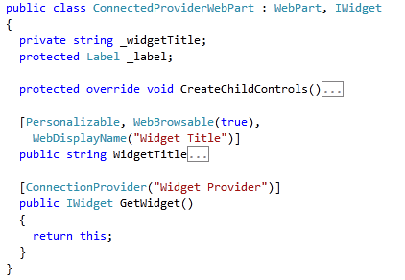
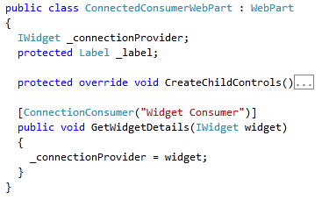
Web Part Connections
Notes:
In this sample code the interface through which the provider Web Part interacts with the consumer Web Part, is the IWidget interface. This interface exposes a number of properties. The provider will pass its data throught an object of this type.

Slide 22
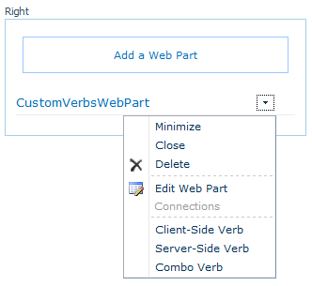
Web Part Verbs
Can add custom menu items to the Web Part menu control
Three types of menu options supported:
Execute client-side script
Execute server-side handler
Execute client-side script, then execute server-side handler
Notes:
In SharePoint 2010 you can add a custom menu item, which is called a verb, to the Web Part dropdown menu of the rendered Web Part. This menu is called the verbs menu. Verbs enable the user to modify the data that appears in the Web Part.
Verbs can execute client-side script, a server-side handler or a combination of both.

Slide 23
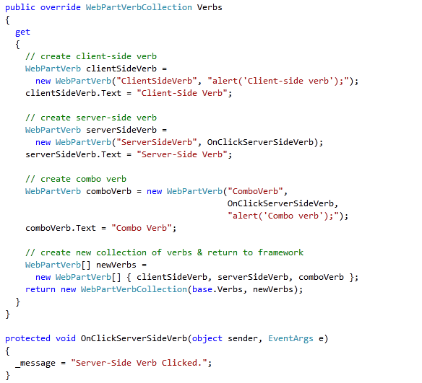
Web Part Verbs
Notes:
In your Web Part code, override the Verbs property. You can create custom Verb objects of type WebPartVerb.
In case of a verb that needs to execute client-side code, you have to pass the following arguments into the constructor: the name of the verb, the JavaScript code or a call to a JavaScript function. You can set the Text property that will be displayed in the Web Part menu.
In case of a verb that needs to execute a server-side event handler, you have to pass the following arguments into the constructor: the name of the verb and the event handler.
In case of a combined verb, you pass in a name, the server-side event handler, and the JavaScript code.
To add your custom menu item you have to use the WebPartVerbCollection, which is an immutable collection. First create an array with your custom verbs and then call the constructor of the WebPartVerbCollection, passing in the existing Verbs collection and your array.

Slide 24
Async Processing with Web Parts
Don’t hold up the entire processing of a page with one Web Part
For long routines, leverage async programming
Database calls
Network calls (Web Services, ATOM feeds, etc.)
Long routines
Fire off async tasks and return control to rest of the page
As async calls complete, they call a successful callback method
If not finished by Page.OnPreRender(), ASP.NET 2.0 waits until they complete / timeout before proceeding
Notes:
If you know that your code will execute for a while and that it can slow down the rendering of your Web Part, it is preferable that you consider asynchronous execution of your code. You can call a method asynchronously passing in a callback method to which the process must return after completing the asynchronous task.
If the asynchronous task is not finished by the time the Page.OnPreRender method is executed, the Web Part will wait until the task completes.

Slide 25
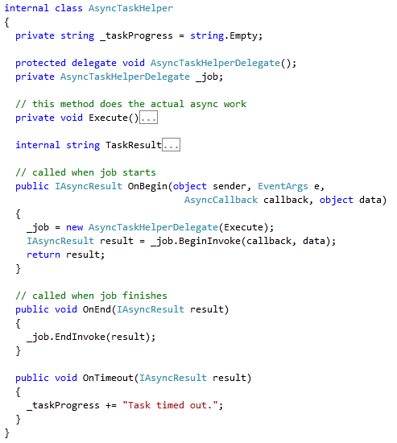
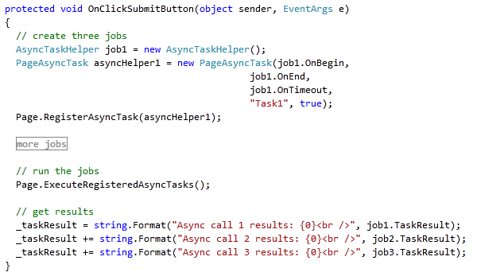
Async Processing with Web Parts
Notes:
The System.Web.UI.PageAsyncTask class makes asynchronous calls easy. There are two steps to using this class:
Create an instance of this class, passing 3 arguments into the constructor:
A delegate to a method that begins your asynchronous task.
A delegate to a method that ends your asynchronous task.
A delegate to a method that needs to execute if your asynchronous task times out.
Register the instance of the PageAsyncTaskwith the System.Web.UI.Page.
The AsyncTaskHelper class is a helper class that encapsulates the methods that are responsible to begin and end your asynchronous task and that simulates a long running proces.

Slide 26
DEMO
Advanced Web Part Development:
Custom Verbs, Connectable Web Parts & Asynchronous Programming

Slide 27
Summary
Overview of Web Parts
Creating Custom Web Parts
Persistent Properties
Custom Editor Parts
Advanced Web Part Development
Connectable Web Parts
Web Parts Verbs
Asynchronous Processing

